Slide 1

WELCOME
to our presentation

Slide 2



Project Title:
KINGDOM OF SOILDER
Presented by
Supervised by
MST. ROKEYA AKTER
Roll : 22102018
Session : 2021-22
Dr. A.H.M KAMAL
Professor
Department of Computer Science and Engineering
Jatiya Kabi Kazi Nazrul Islam University
MD. KHAIRUL ISLAM
Roll : 22102017
Session : 2021-22

Slide 3


ACKNOWLEDGEMENT
Gratitude to the Almighty for granting us the strength and wisdom to initiate and successfully complete this project.
Special thanks to Prof. Dr. A.H.M Kamal for his invaluable guidance and support amidst his busy schedule. Without his direction, we might not have reached our destination.

Slide 4






INTRODUCTION
Here, we will intended the project service
01
OBJECTIVES
Here, we will discuss the objectives of the project
02
GAME FLOW
Here, we will intended the flow of project
TABLE OF CONTENTS
03
DISCUSSION
Here, we will discuss about the game
04
LIMITATIONS
Here, we will intended the limitations of the project
05
FUTURE SCOPES
Here, we will discuss the intended future scope of the project
06

Slide 5




INTRODUCTION
“KINGDOM OF SOLDIER” is a shooter type game
Player makes discission between moving and jumping
The score is based on the player kill the enemy
The player has 3 lives initially

Slide 6

OBJECTIVES
To create a video game using the Pygame library, which is a set of Python modules designed for game development
To create a game that is fun, engaging and entertaining for the players
To develop our skill in game development and programming
To design the game levels that will be simple yet beautiful.
Prepare ourselves for the future for making more advanced game

Slide 7

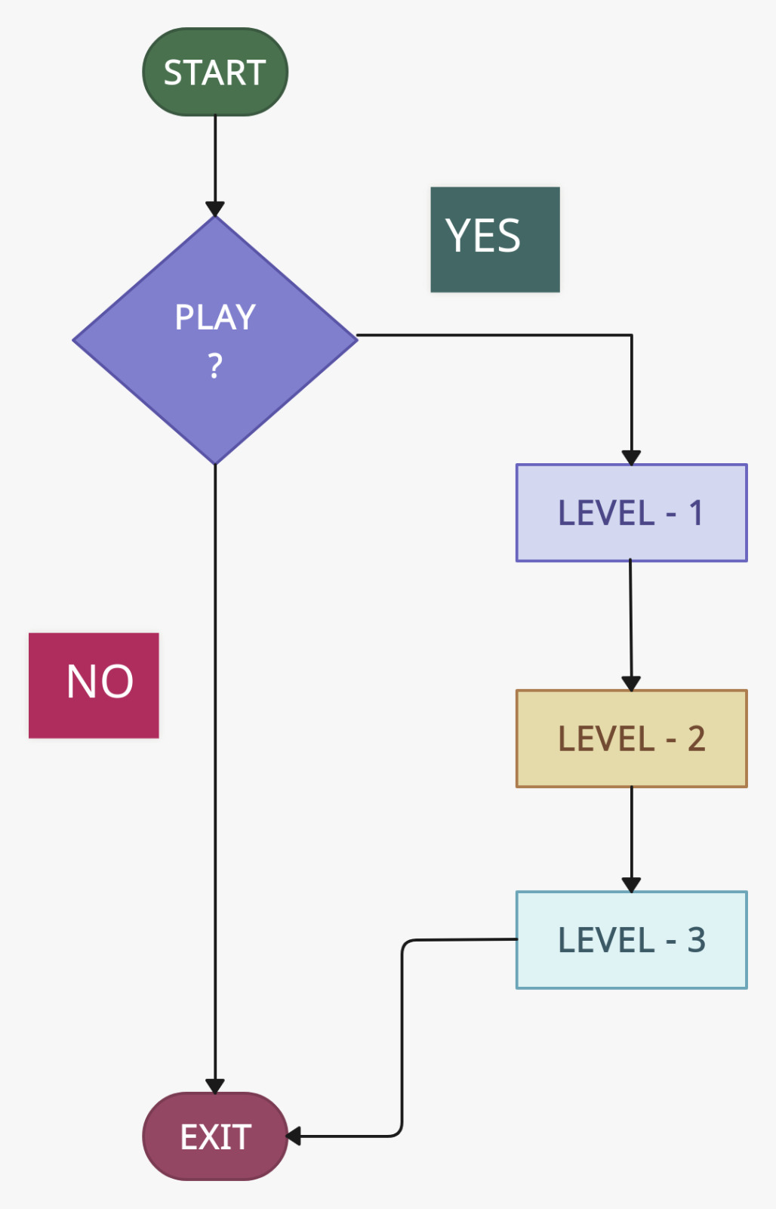

GAME FLOW

Slide 8
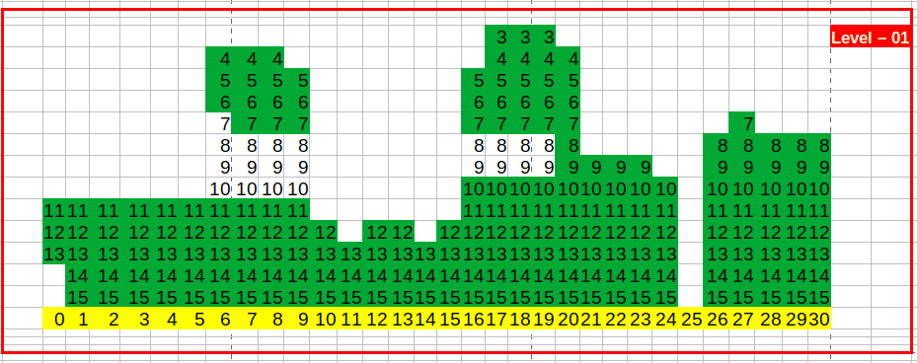
MAP DESIGNING

Slide 9
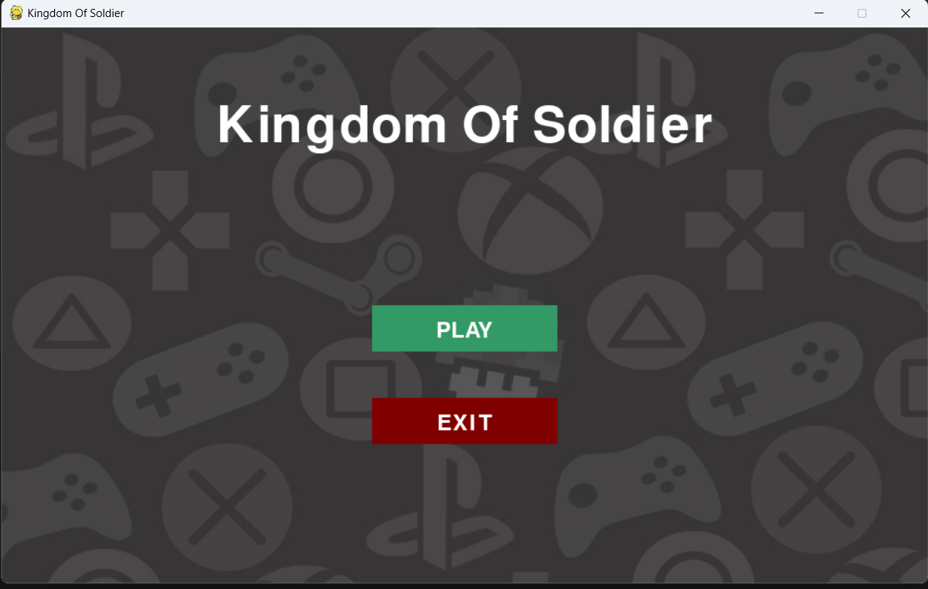
OPENING INTERFACE

Slide 10
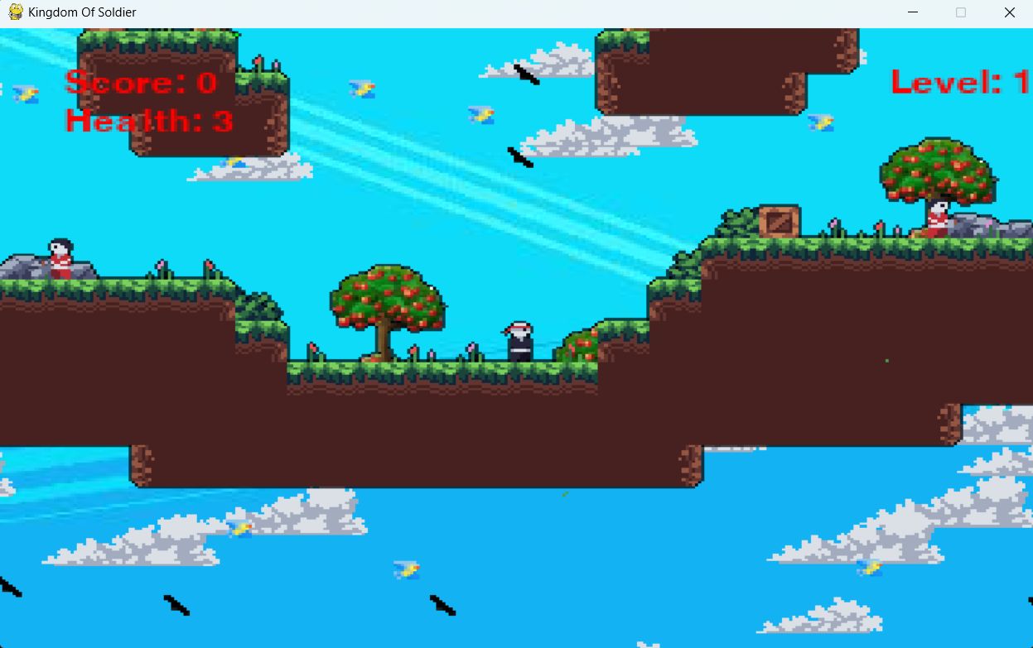
GAME STARTING

Slide 11
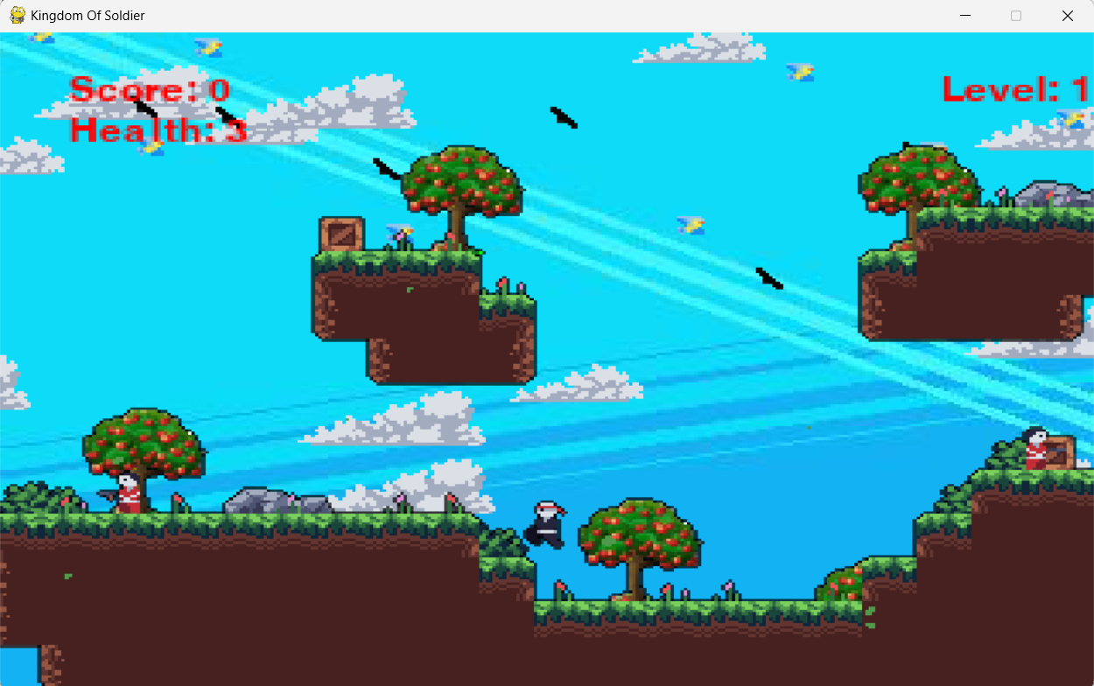
PLAYER JUMP

Slide 12
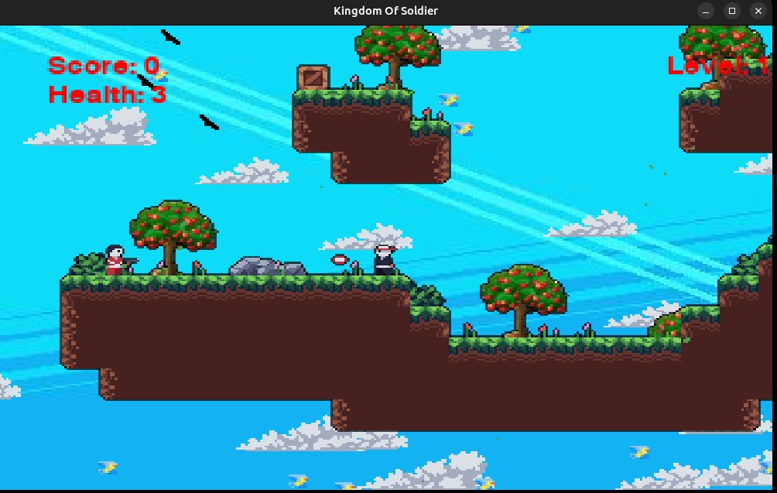
PLAYER AND ENEMY INTERACTIONS

Slide 13
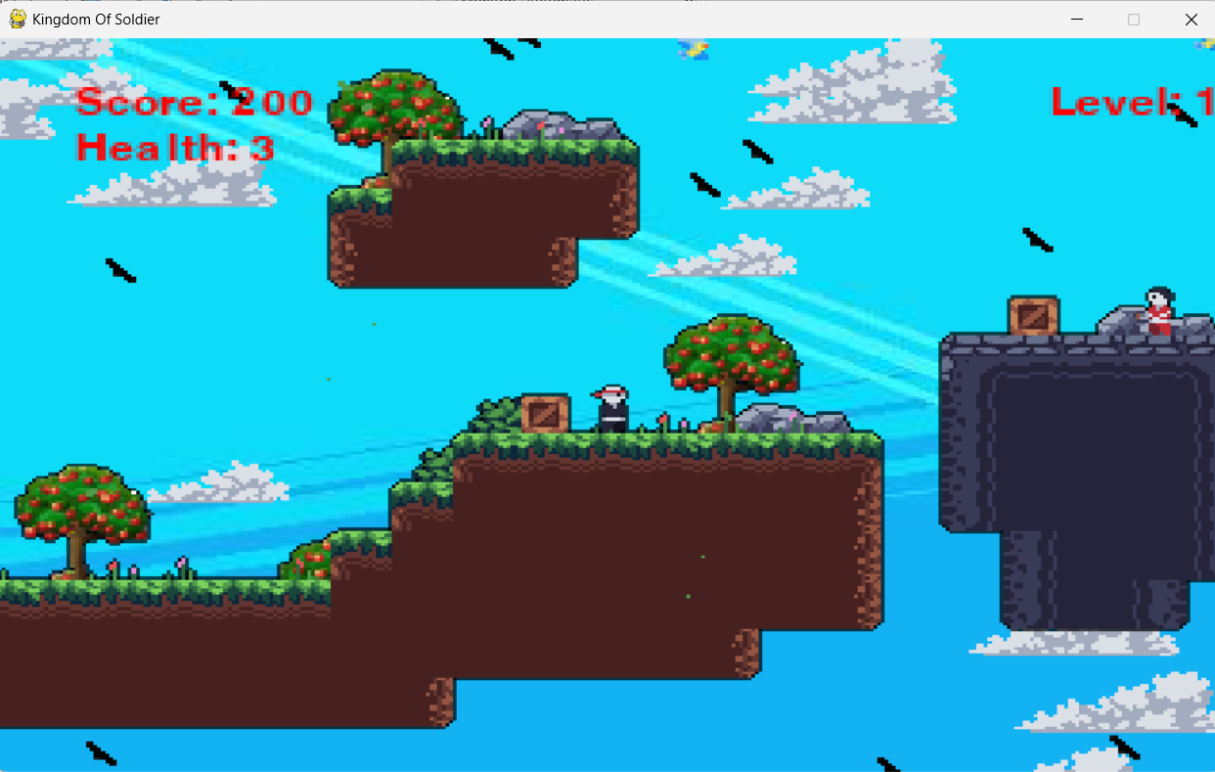
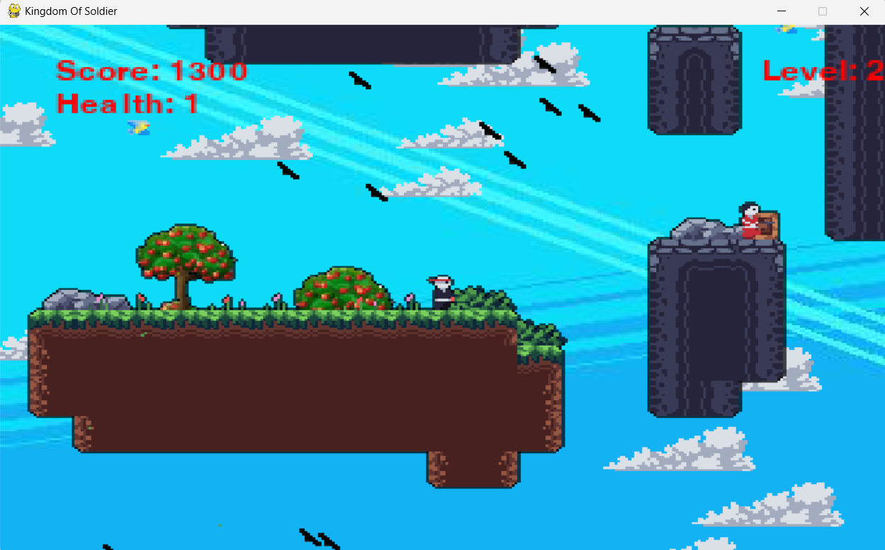
TELEPORTATION

Slide 14
GAMEPLAY SHOWCASE

Slide 15
LIMITATIONS
We can use this game only computer
Only one character for player
Score is not used for anything
It has limited background option

Slide 16



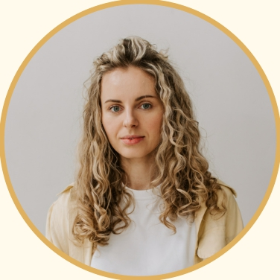
s
FUTURE SCOPES
We will try to run the program in mobile and tab
We can add custom background selection.
We can add character selection option.
We can add a rewarding system with coins.

Slide 17


THANK YOU
FOR YOUR PATIENCE

Slide 18

ANY QUESTIONS

